Slide 1
Chatbot Therapy
01/24
Name: Le Duc Nghia ID:14706
Major: Computer Science Engineering Superviser: Dr. Ngoc Tran Hong
Co-Supervisor: Dr. Dinh Quang Vinh

Slide 2






Table of contents
01
02
03
Introduction
Motivation
Idea
04
05
06
Data Processing
Model
Conclusion
02/24

Slide 3

01
Introduction
03/24

Slide 4

Two columns
Purpose
04/24
Create a chatbot that can recognize emotions through facial expressions, voice, and some psychology quests to understand your current emotions in order to provide therapeutic methods and empathy to help you overcome daily life issues with practical advices.

Slide 5
02
Motivation
05/24

Slide 6



Motivation
Vietnam
Developed countries
06/24
General Motivation

Slide 7

Motivation
Develop countries
07/24
Psychology plays a vital role in understanding mental health. Developed countries like the United States, Europe, and Japan prioritize mental health development to improve their citizens' quality of life.

Slide 8

Motivation
Vietnam
08/24
In Vietnam, psychology has been a distant concern during the past 10-20 years of focusing on economic growth. However, at the present with the improved economy, there is now a growing interest in mental health among the population.

Slide 9

Motivation
General motivation
09/24
This chatbot supports healthcare professionals in providing mental health therapy, improving quality of life, and promoting awareness of the value of mental well-being for a happier society.

Slide 10

03
Idea
10/24

Slide 11




Idea
Emotion Recognition
Survey quests suggestion
Natural Language Preprocessing
Positive solutions
11/24

Slide 12
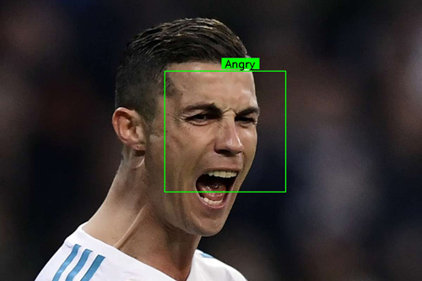

Idea
Emotion Recognition
12/24
Facial Emotion Recognition: Recognizing several emotions:
Angry, Disgust, Fear, Happy, Sad, Surprise,
Neutral

Slide 13
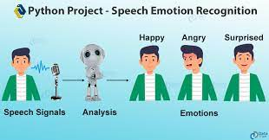

Idea
Emotion Recognition
13/24
Voice Emotion Recognition: Recognizing several emotions:
Angry, Disgust, Fear, Happy, Sad, Surprise,
Neutral

Slide 14
Idea
Survey Quests Suggestion
14/24
Give serveral quest types based on current emotion evaluation

Slide 15
Idea
Natural Language Preprocessing
15/24
Understanding human languages and Psychology concepts

Slide 16
Idea
Positive solutions
16/24
Able to understand people emotion deeply and give some positive feedbacks

Slide 17

Data Processing
04
17/24
You can enter a subtitle here if you need it

Slide 18

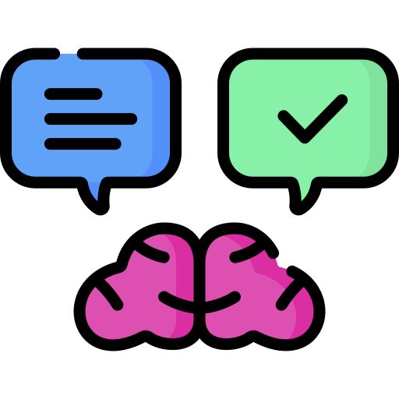

Data Processing
Collect Data
Understanding Data
Preprocessing Data
18/24

Slide 19
Data Processing
Collect Data
19/24
We collect dataset mostly from Kaggle.com with Facial Image Emotion, Voice Image Emotion,… (Adding more later)

Slide 20




Data Processing
01
Data Exploration
02
Data Profiling
03
Domain Knowledge
04
Data Visualization
05
Data Relationships
06
Data Context
20/24
Understandin Data

Slide 21



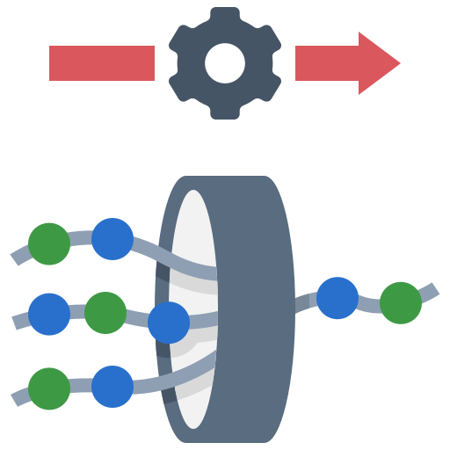

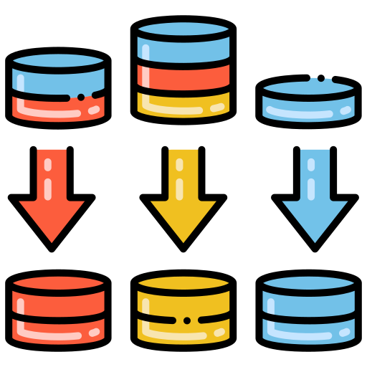
Data Processing
01
Data Cleaning
02
Data Transformation
03
Data Integration
04
Data Reduction
05
Handling Imbalanced Data
06
Normalization
21/24
Preprocessing Data

Slide 22
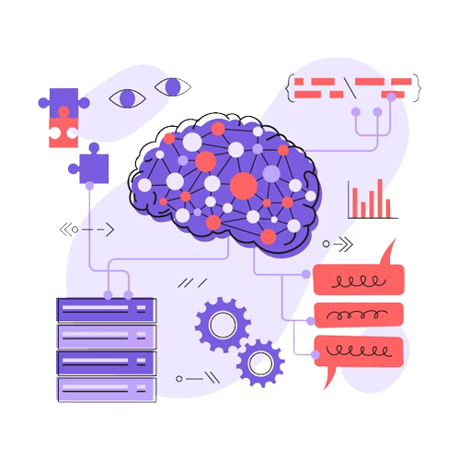
05
Modeling
22/24

Slide 23

06
Conclusion
23/24

Slide 24
Thanks!
24/24
Do you have any questions?

